Slide 1
Programming in C
By
MS KRITI KAUSIK
kriti29kausik@gmail.com

Slide 2
Functions
Unit III

Slide 3
Contents
Introduction to
Library Functions
User Defined Functions
Call by Value and Call By Reference
Functions Calling
Arrays with Functions
argc and argv
Recursion
Basic Concepts
Tower of Hanoi

Slide 4
Function
A function is a named unit of a group of program statements designed to perform a specific task and returns a single value.
C language supports two types of functions. They are
i. Built-in or library functions.
ii. User defined functions
Uses of Functions
Repetition – Avoids rewriting
Universal use – Global access
Simple solver – Complexity tasks can be solved
Efficiency – once declaration multiple use

Slide 5
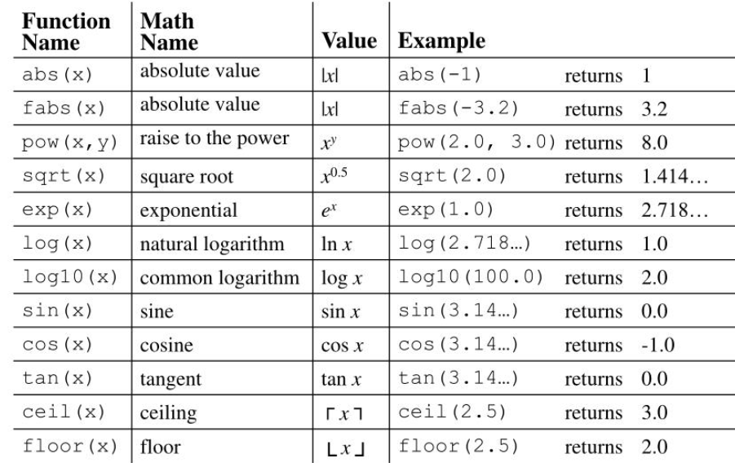
Built-in Function
A function defined by the C compiler.
It is also called readymade functions/predefined function.
This type of functions already defined, so user can make use directly.
Ex: sqrt(), ceil(), floor(), abs(), pow
In order use above functions user must include math.h header file

Slide 6
Built-in Function Simple Examples
#include<stdio.h>
#include<conio.h>
void main()
{
float x=56.79;
printf(“%f”, ceil(x));
printf(“%f”, floor(x));
}
Output = 57 56
#include<stdio.h>
#include<conio.h>
void main()
{
int x=90,y=60, z=45;
clrscr();
printf(“%d”, sin(x));
printf(%f”, cos(y));
printf(“%d”, tan(z));
getch();
}
Output = 1 0.5 1
#include<stdio.h>
#include<conio.h>
void main()
{
int a=36, b;
clrscr();
b=sqrt(a);
printf(“%d”, b);
getch();
}
Output = 6

Slide 7

Builtin Function – Example
#include<stdio.h>
#include<conio.h>
void main()
{
int a=10,b,q,r,s,m,n;
float x=12,y,z,p,t,u,v,o;
clrscr();
b=sqrt(a);
y=cos(x);
z=sin(x);
p=tan(x);
q=abs(-17.63);
r=floor(15.18);
s=ceil(15.1);
t=1/tan(x);
u=1/sin(x);
v=1/cos(x);
m=pow(a,2);
n=pow(a,3);
o=log(x);
Output:
Sqrt value:3
Cos value:0.843854
Sin value: -0.536573
Tan value:-0.635860
Abs value:17
Floor value:15
Ceil value:16
Cot value: -1.572673
Cosec value: -1.863680
Sec value:1.185039
Pow value:100
Powc value:1000
Log value:2.484907
printf(“Sqrt value:%d\n”,b);
printf(“Cos value:%f\n”,y);
printf(“Sin value:%f\n”,z);
printf(“Tan value:%f\n”,p);
printf(“Abs value:%d\n”,q);
printf(“Floor value:%d\n”,r);
printf(“Ceil value:%d\n”,s);
printf(“Cot value:%f\n”,t);
printf(“Cosec value:%f\n”,u);
printf(“Sec value:%f\n”,v);
printf(“Pow value:%d\n”,m);
printf(“Powc value:%d\n”,n);
printf(“Log value:%f\n”,o);
getch();
}

Slide 8
User Defined Functions
A function defined by the user.
User can give any name to the function.
User can’t set the keyword as the function name.
Benefits of Functions
Programs with functions are compact thus decreasing the number of lines of code to a very large extent.
Debugging the code is much simpler because errors can be localized and corrected easily.
Functions increase the readability of the program and helps in proper and good documentation.
Many other programs may use a function, thus helping us to create our own libraries.

Slide 9
User Defined Functions
Syntax
Function Parts/Components
Function Declaration
Function Call
Function Body/Definition
Types
Returntype function name(list of arguments)
{
set of statements;
return exp;
}
No return value no arguments
No return type with arguments
Return type with arguments
Return type without arguments

Slide 10
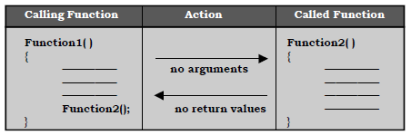
User Defined Functions
Type1: No Return Type without Arguments
Definition: This function did not accept any arguments and not return any values
Example Program
#include<stdio.h>
#include<conio.h>
void demo(); //function declaration
void main()
{
clrscr();
printf(“\n Before function:”);
demo(); //function calling
printf(“\n After function”);
getch();
}
void demo() //function body
{
printf(“\n **********”);
printf(“\n **********”);
}
Output:
Before function
**********
**********
After function

Slide 11
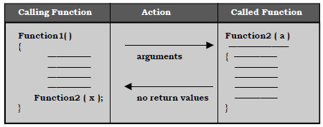
User Defined Functions
Type2: No Return Type with Arguments
Definition: This function takes one or more(some) number of arguments and not return any values
Example Program
#include<stdio.h>
#include<conio.h>
void demo(int,int); //function declaration
void main()
{
int x=10,u=10;
clrscr();
printf(“\n Before function:”);
demo(x,u); //function calling
printf(“\n After function”);
getch();
}
void demo(int a,int b) //function definition
{
int c=a+b;
printf(“\n %d”,c);
}
Output:
Before function
20
After function

Slide 12
User Defined Functions
Type3: Return Type without Arguments
Definition: This function takes no arguments and return some values based on its data types
Example Program
#include<stdio.h>
#include<conio.h>
void main()
{
int add(); //function declaration
int r;
clrscr();
r=add(); //function calling
printf(“\n Addition%d:”,r);
getch();
}
int add() //function definition
{
int a,b,c;
a=1,b=2;
c=a+b;
return(c);
}
Output:
Addition: 3

Slide 13
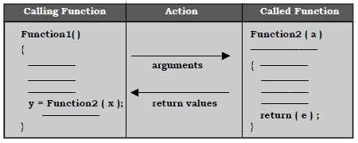
User Defined Functions
Type4: Return Type with Arguments
Definition: This function takes one or more (some) number of arguments and return some values based on its data types
Example Program
#include<stdio.h>
#include<conio.h>
int demo(int,int); //function declaration
void main()
{
int x=10,u=5;
clrscr();
printf(“\n Before function:”);
printf(“\n After function:%d”,demo(x,u)); //function calling
getch();
}
int demo(int a,int b) //function definition
{
int c=a-b;
return c;
}
Output:
Before Function
After Function: 5

Slide 14
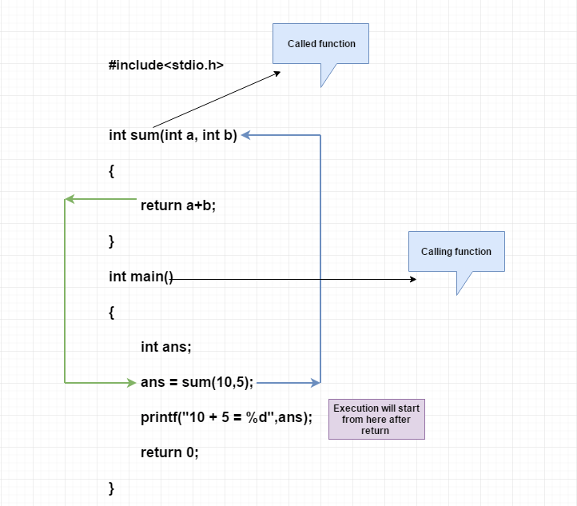
Example

Slide 15
Factorial Using Functions - Example
#include<stdio.h>
#include<conio.h>
int Fact(int);
void main()
{
int n;
clrscr();
printf("\n Enter the Number for N");
scanf("%d", &n);
printf("\n The Factorial Value is:%d", Fact(n));
getch();
}
int Fact(int K)
{
int Fact=1, i;
for(i=1; i<=K; i++)
{
Fact = Fact * i;
}
return Fact;
}
Output:
Enter the Number for N: 5
The Factorial Value is: 120

Slide 16
Call by Value Function
#include<stdio.h>
#include<conio.h>
void main()
{
int x=10,y=5;
void demo(int,int);
clrscr();
printf(“\n\n Before swapping X:%d,Y:%d”,x,y);
demo(x,y);
getch();
}
void demo(int a,int b)
{
int temp;
temp=a;
a=b;
b=temp;
printf(“\n\n After swapping X:%d,Y:%d”,a,b);
}
Output:
Before swapping X:10, Y:5
After swapping X:5, Y:10

Slide 17
Call by Reference Function
#include<stdio.h>
#include<conio.h>
void main()
{
int x=10,y=5;
void demo(int *,int *);
clrscr();
printf(“\n Address are Before swapping X:%u,Y:%u”,&x,&y);
demo(&x, &y);
getch();
}
void demo(int *a,int *b)
{
int *temp;
temp=a;
a=b;
b=temp;
printf(“\n Address are After swapping X:%u,Y:%u\n”,a,b);
}
Output:
Before swapping X:65524
Y:65522
After swapping X:65522
Y:65524

Slide 18
Functions with Arrays
Arrays can be used with functions
#include<stdio.h>
#include<conio.h>
int avg(int[]);
void main()
{
int marks[5]={98, 99, 100, 96, 94};
clrscr();
printf("\n Average is: %d", avg(marks));
getch();
}
int avg(int sum[])
{
int i, cal=0;
for(i=0;i<5;i++)
{
cal = cal + sum[i];
}
return cal/5;
}
Output:
Average is : 97

Slide 19
Example program for argc and argv
It is possible to pass some values from the command line to user’s C programs when they are executed. These values are called command line arguments and many times they are important for user program especially when they want to control the program from outside.
The command line arguments are handled using main() function arguments where
argc refers to the number of arguments passed, and
argv[] is a pointer array which points to each argument passed to the program

Slide 20
Example program for argc and argv
#include <stdio.h>
int main (int argc, char *argv[])
{
int i=0;
printf("\ncmdline args count=%s", argc);
printf("\nexe name=%s", argv[0]);
for (i=1; i< argc; i++)
{
printf("\narg%d=%s", i, argv[i]);
}
printf("\n");
return 0;
}
Output
$ ./cmdline_basic test1 test2 test3 test4 1234 56789
cmdline args count=7
exe name=./cmdline_basic
arg1=test1
arg2=test2
arg3=test3
arg4=test4
arg5=1234
arg6=56789
Note: It holds value ‘7’ (in which one argument is executable name and ‘6’ are arguments passed to program

Slide 21
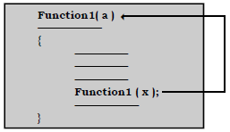
Recursive Function
In many situations it is possible for users to have functions that call itself directly or indirectly again and again. Such functions are termed as recursive functions and the process is termed as recursion.
Many algorithm and mathematical definitions are naturally described recursively
A function is called by itself which is known as ‘Recursive function’

Slide 22

Recursive Function for Fibonacci Series – Example
#include <stdio.h>
int fibo( int );
void main( )
{
int i,n;
printf(“Enter number of elements in the series \n”);
scanf(“%d”,&n);
printf(“\nFibonacci numbers\n\n”);
for(i=1;i<=n;i++)
printf(“%d\t”,fibo(i)); /* Function call */
}
/* Function to find fibonacci numbers */
int fibo(int k)
{
if(k ==1)
return(0);
else if(k==2)
return(1);
else
return(fibo(k-1)+fibo(k-2));
}

Slide 23
Tower of Hanoi – Recursion Application Example
The Tower of Hanoi (also called the Tower of Brahma or Lucas’ Tower and sometimes pluralized) is a mathematical game or puzzle.
Rules
Only one disk can be moved at a time.
Each move consists of taking the upper disk from one of the stacks and placing it on top of another stack i.e. a disk can only be moved if it is the uppermost disk on a stack.
No disk may be placed on top of a smaller disk.

Slide 24
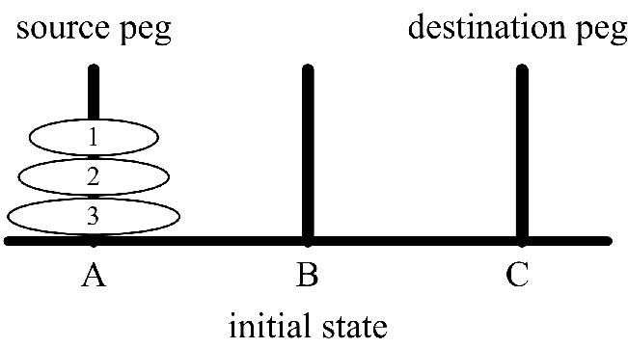
Tower of Hanoi – Recursion Application Example
#include <stdio.h>
#include <conio.h>
void toh(int, char, char, char);
void main()
{
int n;
printf("Enter the number of disk : ");
scanf("%d", &n);
printf("Here is sequence of moves of tower of hanoi :\n");
toh(n, 'A', 'C', 'B');
}
void toh(int no, char source, char destination, char spare)
{
if (no == 1)
{
printf("\n move disk 1 from source %c to destination %c", source, destination);
return;
}
toh(no - 1, source, spare, destination);
printf("\n move disk %d from source %c to destination %c", no, source, destination);
toh(no - 1, spare, destination, source);
}

Slide 25
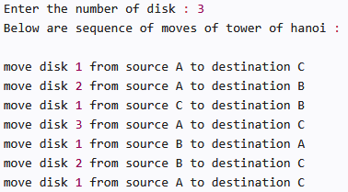
Tower of Hanoi – Recursion Application Example
Output

Slide 26
Credits
https://www.thegeekstuff.com/2013/01/c-argc-argv/
https://www.stechies.com/tower-of-hanoi-c/
https://dotnettutorials.net/lesson/tower-of-hanoi-using-recursion-in-c/
https://meeraacademy.com/c-program-for-tower-of-hanoi-using-recursion/
https://www.tutorialspoint.com/cprogramming/c_command_line_arguments.htm

Slide 27
Roadmap for Unit III
Introduction to Functions
Call by Value and
Call by Reference
Recursion and Tower of Hanoi
1
3
5
2
4
6
Built-in and User defined Functions
Functions with Array, argc and argv
Summary

Slide 28

Roadmap to Programming in C
Unit I
Computer Based Problem Solvingand Overview of C
Unit III
Functions and Recursions
Unit V
File Handling, Preprocessor, Standard Library and Header Files
1
3
5
2
4
6
Unit – II
Branching, Looping, Arrays, Strings
Unit IV
Dynamic Data Structures, Pointers, Union
Revision

Slide 29
Feedback – Rating Star
Communication, Presentation, Examples and Exercises
$90
Communication, Presentation, Exercises
$80
Communication, Presentation, Exercises
$60
Communication, Presentation, Example
$50
Communication, Presentation
$40
Communication only
$30

Slide 30
Thanks!
Any questions?
You can find me at:
kriti29kausik@gmail.com

